Slide 1


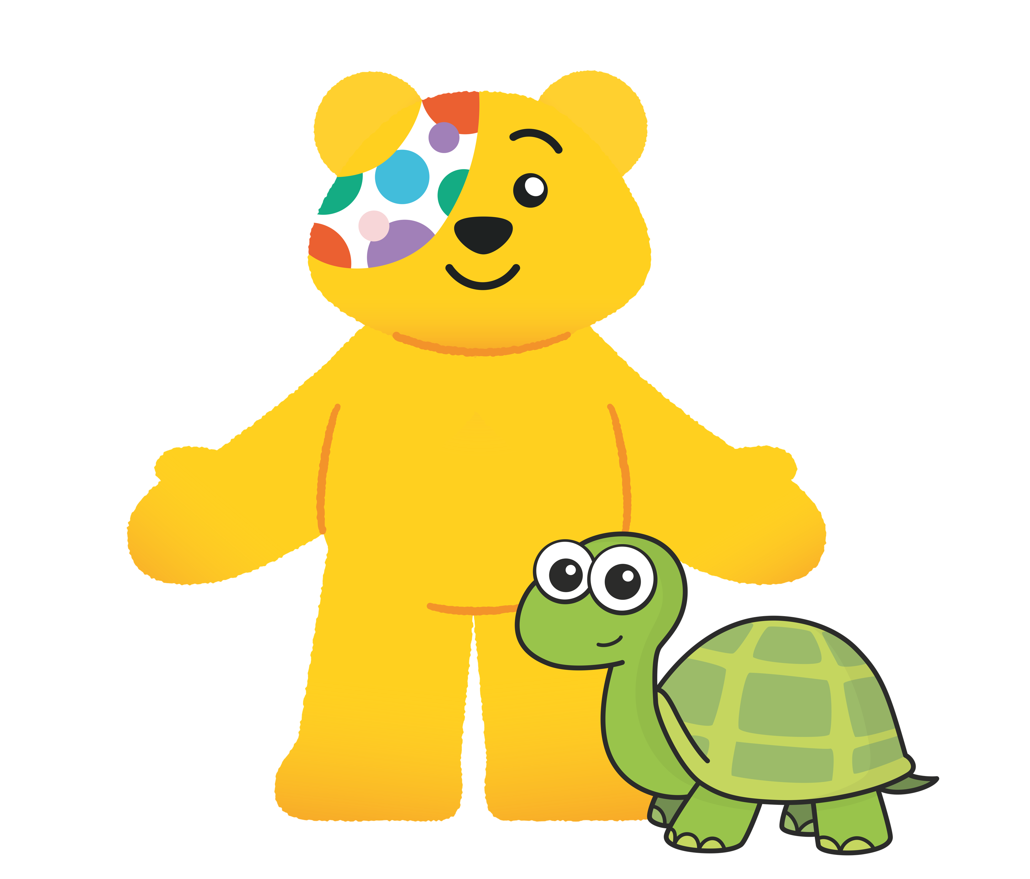


Slide 2
Guidance for teachers
These slides contain 5 daily maths challenges that can be used in the run up to BBC Children in Need day (Friday 15th November 2024). It would be useful to have coins available for some of the challenges so children can work practically.
Each challenge is followed by a page of suggested discussion prompts to raise children’s awareness of those needing help and how BBC Children in Need can make a difference.
The final discussion prompt encourages schools to consider how they could support BBC Children in Need. You can find some suggestions here or here.
We hope you enjoy the challenges. Let us know how you get on!

Slide 3
Challenge 1
Jack donates some coins to BBC Children in Need.
He donates more than £1 and less than £1.50
All of the coins he donates are different.
How much money could Jack have donated?
There are 31 different possible answers.
Can you find them all?

Slide 4
Answers
Jack could have donated:
£1.01, £1.02, £1.03, £1.05, £1.06, £1.07, £1.08, £1.10, £1.11, £1.12, £1.13, £1.15, £1.16, £1.17, £1.18, £1.20, £1.21, £1.22, £1.23, £1.25, £1.26, £1.27, £1.28, £1.30, £1.31, £1.32, £1.33, £1.35, £1.36, £1.37, £1.38
Jack could not have donated any amounts that include 4p or 9p or 40p.
Can you explain why?

Slide 5
Points to discuss
What is BBC Children in Need?
Why might some children need help?
How does BBC Children in Need help?

Slide 6
Notes from BBC Children in Need
What is BBC Children in Need?
BBC Children in Need is a charity that helps disadvantaged children across the UK. Our vision is that every child in the UK has a safe, happy and secure childhood and the chance to reach their potential.
Why might some children need help?
Some children in the UK are facing challenges and difficulties such as: disability, life-changing illness, living in poverty or caring for somebody in their family.
How does BBC Children in Need help?
BBC Children in Need is currently supporting over 1,500 local charities and projects in communities across the UK that are helping children and young people. BBC Children in Need also helps us to think about other children that might not be as fortunate as us and encourages everyone to get involved and raise money to help others.

Slide 7
Challenge 2
On the 1st November, Jo saves 5p.
On the 2nd, Jo saves 10p.
On the 3rd, Jo saves 15p.
Jo continues to save 5p more each day.
How much will Jo save in total after 1 week?
How much will Jo save in total after 2 weeks?
How much will she save during the whole of November?

Slide 8
Answers
Jo saves £1.40 in one week.
Jo saves £5.25 in two weeks.
Jo saves £23.25 in November.

Slide 9
Points to discuss
Do small donations make a difference?
Why is it important for BBC Children in Need to
receive donations?

Slide 10
Notes from BBC Children in Need
Do small donations make a difference?
Yes, small donations can make a big difference to children who need our support. For example, £2 pays for a hygiene pack for a 10-year-old affected by poverty, providing basics like toothpaste and body wash to help improve health and confidence.
Why is it important for BBC Children in need to receive donations?
BBC Children in Need is a fundraiser and grant maker. That means that we ask the public to raise and donate lots of money so that we can make a difference to the children and young people who need us most – right across the UK.

Slide 11


Challenge 3
Three buckets each contain some £1 coins.
The green bucket has twice as many as the red.
The yellow bucket has 10 more than the green.
How many £1 coins could there be in total?
Do you notice a pattern?

Slide 12
Answers
Multiple possible answers, for example:
Red | Green | Yellow | Total
1 | 2 | 12 | 15
2 | 4 | 14 | 20
3 | 6 | 16 | 25
4 | 8 | 18 | 30
The total is always a multiple of 5

Slide 13
Points to discuss
How is BBC Children in Need funded?
What help does BBC Children in Need offer in your local area?
Click here to find out!

Slide 14
Notes from BBC Children in Need
How is BBC Children in Need funded?
People across the UK get involved in fundraising for BBC Children in Need. They often get sponsored to do something challenging like running, cycling or baking. This fundraising money is then used by BBC Children in Need to support charities across the UK who support disadvantaged children in their local communities.
What help does BBC Children in Need offer in your local area?
Use the BBC Children in Need’s interactive map to see what help is offered in your local area.

Slide 15
Challenge 4
Kim gives £2.05 to BBC Children in Need.
What coins could Kim have used if she gave…
2 coins?
3 coins?
4 coins?
5 coins?
Any number of coins up to 10 coins?

Slide 16
Answers
There are multiple possible answers, for example:
2 coins - £2, 5p 3 coins - £1, £1, 5p
4 coins - £2, 2p, 2p, 1p 5 coins - £1, £1, 2p, 2p, 1p
6 coins - £2, 1p, 1p, 1p, 1p, 1p
7 coins - £1, £1, 1p, 1p, 1p, 1p, 1p
8 coins - £1, 50p, 50p, 1p, 1p, 1p, 1p, 1p
9 coins - £1, 50p, 20p, 20p, 10p, 2p, 1p, 1p, 1p
10 coins - 50p, 50p, 20p, 20p, 20p, 20p, 20p, 2p, 2p, 1p

Slide 17
Points to discuss
Have you ever helped fundraise for BBC Children
in Need?
Apart from giving money, what other ways can you help people?
How does it make you feel when you help others?
Click here to meet some of the young people who have been supported thanks to BBC Children in Need.

Slide 18
Challenge 5
The gladiators are taking part in a sponsored swim
to raise money for BBC Children in Need.
Here is Legend’s sponsor form.
Legend swims 14 lengths of a 25 m pool.
How much money does he raise?
Gladiator | Amount
Fire | 35p per length
Nitro | £8 total
Fury | 3p per metre swam
Apollo | £0.50 per 10 metres swam

Slide 19
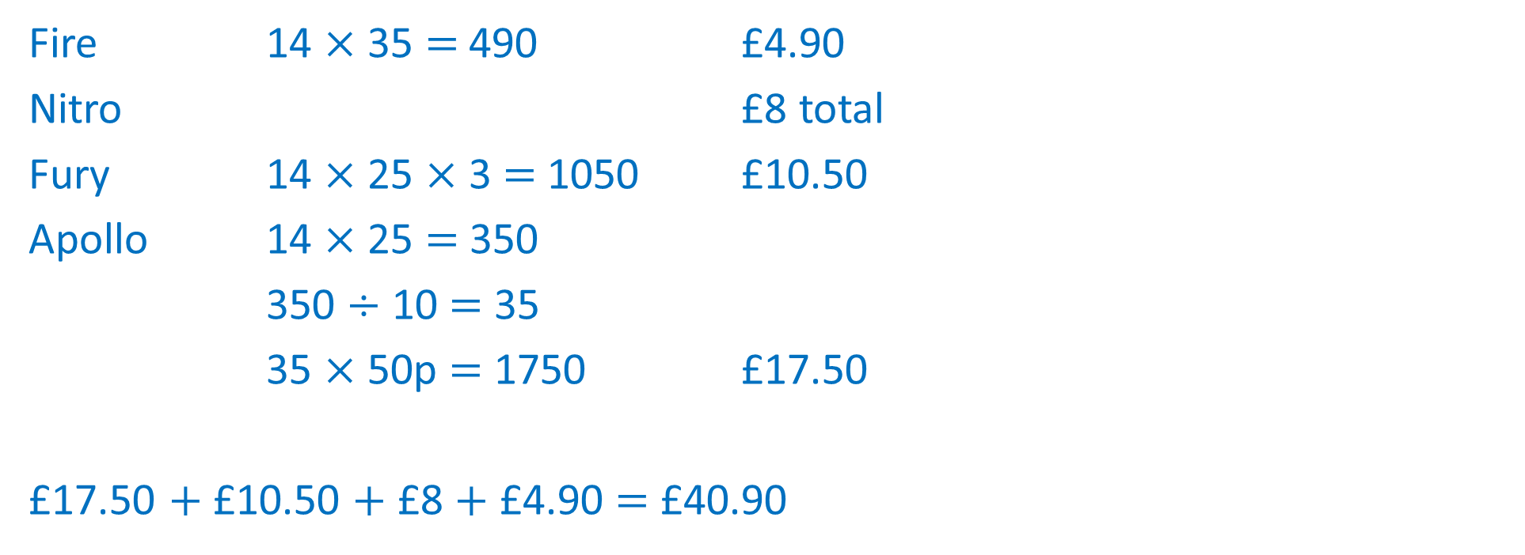
Answers
Fire 14 $×$ 35 $=$ 490 £4.90
Nitro £8 total
Fury 14 $×$ 25 $×$ 3 $=$ 1050 £10.50
Apollo 14 $×$ 25 $=$350
350 $÷$ 10 $=$ 35
35 $×$ 50p $=$ 1750 £17.50
£17.50 $+$ £10.50 $+$ £8 $+$ £4.90 $=$ £40.90
Total raised is £40.90

Slide 20
Points to discuss
Have you ever taken part in a sponsored event?
What does it mean to be sponsored?
What sort of things could you do to raise money for
BBC Children in Need?

Slide 21




Can you organise an event to raise money for
BBC Children in Need?
Remember, small amounts can make a big difference!

