Slide 2
What Is BBC Children in Need?
BBC Children in Need is a charity that helps children all over the UK.
All children should be able to play, be safe, be happy, healthy and cared for.
Sadly, this doesn’t always happen but BBC Children in Need works hard to help all children smile.

Slide 3
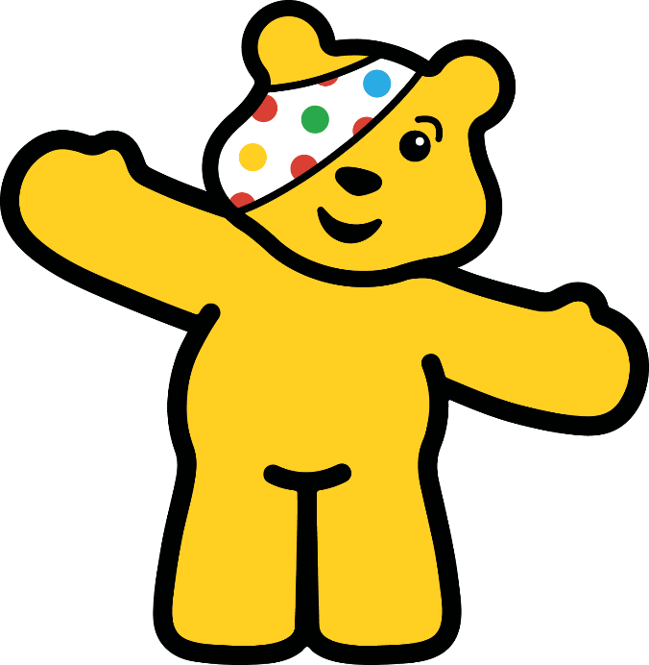
Pudsey Bear
Pudsey Bear is a very special friend to BBC Children in Need.
Pudsey Bear loves to see everyone having fun and helping to raise money.
Pudsey also loves spotty things!

Slide 4
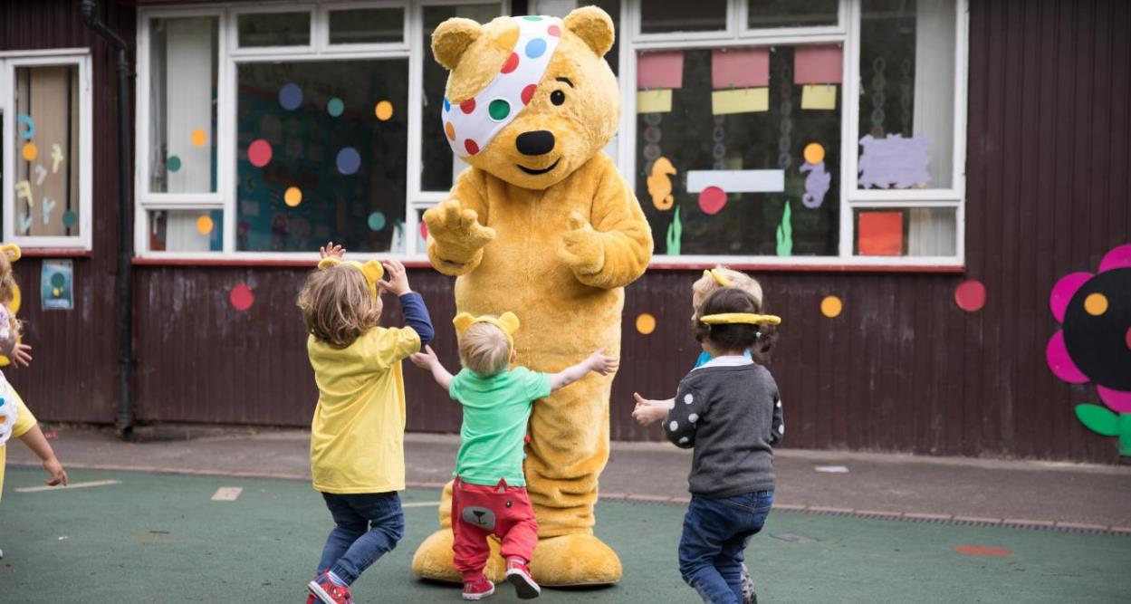
Pudsey Bear
Pudsey loves seeing all children happy and smiling!

Slide 5
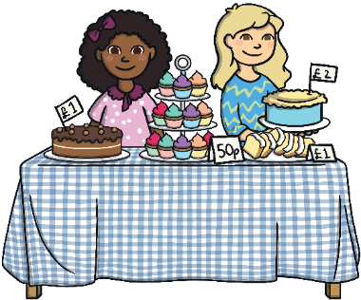
What Happens on BBC Children in Need Day?
BBC Children in Need Day is very exciting.
Lots of people dress up and do fun things to raise money.
In the evening, BBC Children in Need present a programme on television. You can watch the fun things people have done during the day and see how much money has been raised.

Slide 6
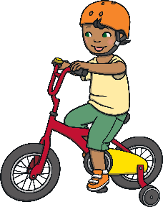
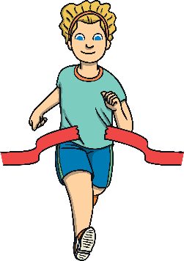
Raising Money for BBC Children in Need
Many children’s lives have changed for the better thanks to BBC Children in Need.
People all over the UK raise money to help BBC Children in Need. People do lots of amazing challenges and fun events, such as:
wear fancy dress
have a cake sale
have a sponsored silence
take part in a race
set themselves a really hard challenge
have a dance-a-thon

Slide 7
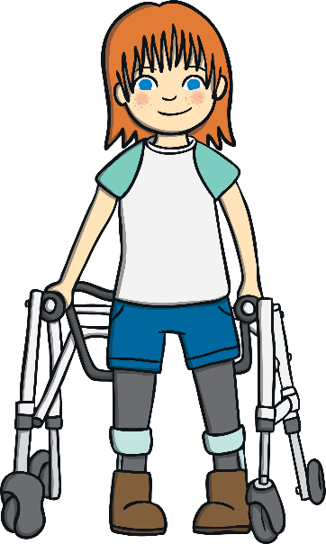
Where Does the Money Go?
BBC Children in Need collect all of the money that everyone has kindly donated.
They add the money up and let everyone know how much money they have raised. This money is all used to make children’s lives better and happier.

Slide 8
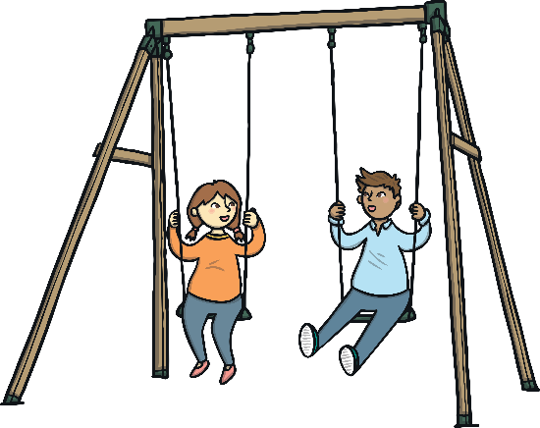
What Is the Money Used For?
The money might be used for:
giving support to poorly children and their families
helping children stay safe and warm
giving children a safe place to go and have fun

Slide 9
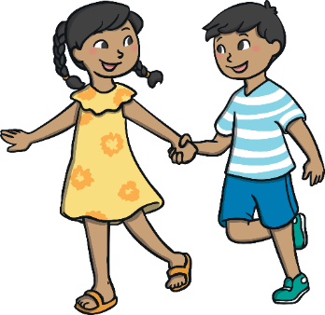
What Can You Do?
What fun things could you do to raise money for BBC Children in Need?
You might already be doing something fun for BBC Children in Need Day. If you are, can you tell a friend about it?

